Slide 1

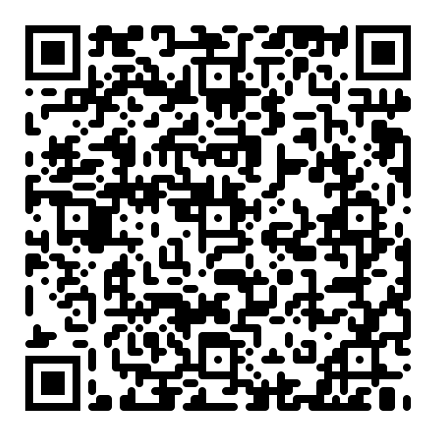
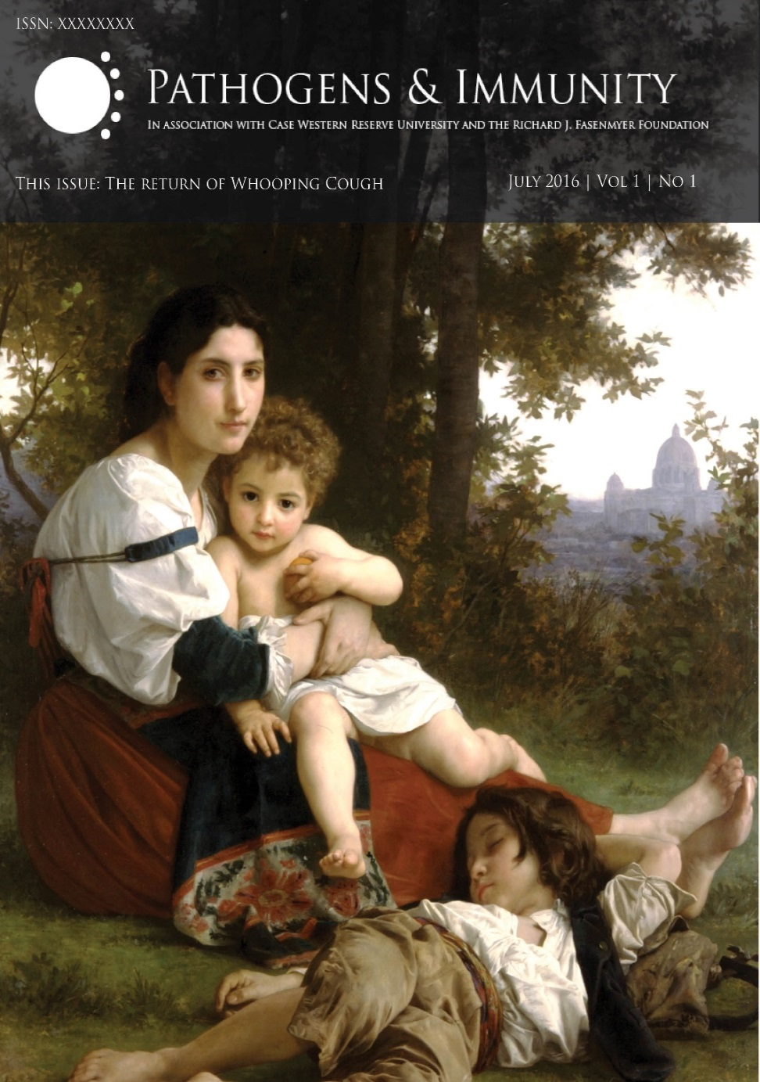
www.paijournal.com
A Free Open Access Journal designed to make your life better
Submission online takes less than 5 minutes
Submit in any format (reformat if accepted)
No fees to authors for submission or publication
Reviewers are paid for timely reviews
Median time to editorial decision – 14 days
Listed on PubMed, Google Scholar, NCBI
Funded by a lifetime endowment
2023 Cite Score Tracker – 10.6
Video Interviews free on website with prominent scientists, including:
Anthony Fauci – former director of NIAID, Lasker Award
Drew Weissman – 2024 Nobel Prize - mRNA
David Baltimore – 1975 Nobel Prize - Reverse Transcriptase
Raymond Schinazi – discovery of the anti-hepatitis C agent sofosbuvir
Vishva Dixit – study of innate immunity and the understanding of
inflammasome activation

